Slide 1



CLOUD
COMPUTING

Slide 2
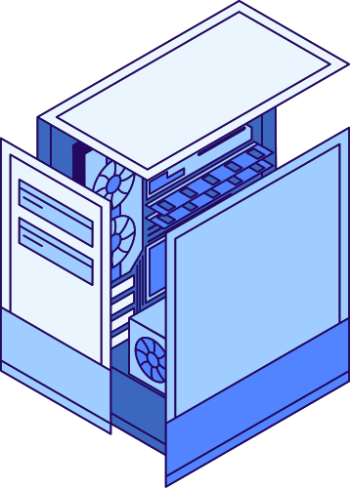
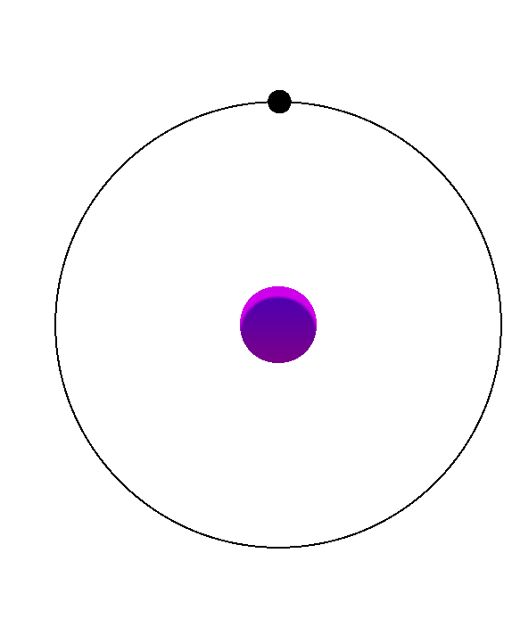
DEFINITION
Cloud computing refers to the delivery of computing services, such as servers, storage, databases, software, and networking, over the Internet. Instead of relying on local servers or personal devices, users can access and utilize these resources from anywhere, at any time, using any internet-connected device.

Slide 3
1. On-Demand Self-Service
2. Broad Network Access
3. Resource Pooling
4. Rapid Elasticity
5. Measured Service
6. Multi-tenancy
7. Service Models
8. Reduced Cost
9. Scalability
10. Remote Access
ESSENTIALS OF
Cloud Computing

Slide 4
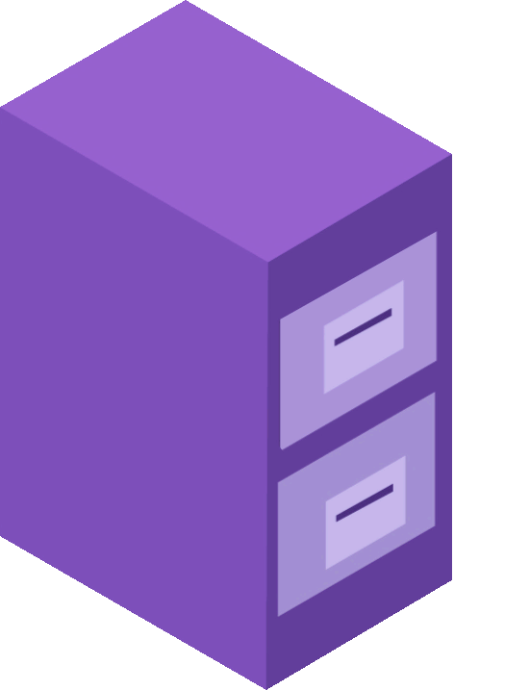
SERVICE
MODELS
IAAS
PAAS
SAAS

Slide 5

INFRASTRUCTURE AS A SERVICE (IAAS)
Infrastructure as a Service (IaaS) is the foundation of cloud computing, providing virtualized computing resources over the internet. With IaaS, organizations can outsource the infrastructure needed to support their applications and systems, including servers, storage, and networking components.
Amazon Web Services
Microsoft Azure
Google Cloud Platform
IBM Cloud
Examples

Slide 6
PLATFORM AS A SERVICE (PAAS)
Platform as a Service (PaaS) builds upon IaaS by providing a complete platform for developing, deploying, and managing applications. PaaS offers a development environment in the cloud, enabling developers to focus on application logic without worrying about the underlying infrastructure.
Heroku
Microsoft Azure App Service
Google App Engine
AWS Elastic Beanstalk
Examples

Slide 7
SOFTWARE AS A SERVICE (SAAS)
Software as a Service (SaaS) is a cloud computing model that delivers software applications over the internet on a subscription basis. With SaaS, users can access and use applications hosted in the cloud without the need for installation or maintenance.
Salesforce
Microsoft 365
Google Workspace
Dropbox
Examples

Slide 8
TYPES OF CLOUD
COMPUTING
Public cloud
Private Cloud
Community Cloud
Hybrid Cloud

Slide 9
PUBLIC CLOUD
Public cloud refers to a type of cloud computing deployment model in which cloud services and infrastructure are provided and managed by third-party service providers and made available to the general public over the internet. In a public cloud, multiple organizations or users share the same pool of computing resources, such as virtual machines, storage, and networking infrastructure.

Slide 10
PRIVATE CLOUD
A private cloud is a computing environment that is dedicated to a single organization or entity. It is designed to offer the benefits of cloud computing, such as scalability, flexibility, and self-service provisioning while providing a higher level of control, security, and privacy compared to public cloud offerings. In a private cloud, the infrastructure and resources are owned and operated by the organization itself or by a third-party provider exclusively serving that organization.

Slide 11
COMMUNITY CLOUD
A community cloud is a type of cloud computing deployment model that is shared by multiple organizations or entities with common interests or requirements. It is designed to provide a collaborative and shared computing environment while addressing the specific needs and concerns of a particular community. In a community cloud, the infrastructure, applications, and resources are accessible and used by multiple organizations that belong to the same community.

Slide 12
HYBRID CLOUD
Hybrid cloud is a cloud computing environment that combines the use of both public and private cloud services, allowing organizations to leverage the benefits of both models. It enables seamless integration and orchestration between public and private clouds, creating a unified infrastructure that offers flexibility, scalability, and control. In a hybrid cloud, applications, data, and workloads can be dynamically distributed between public and private cloud resources based on specific requirements.

Slide 14



THANK YOU!
+91 9985326634
https://www.linkedin.com/in/warlu-naalla
venkateshwarluchinnunaalla@gmail.com

